Slide 1
Relational Database Design
Normalization of Relational Databases

Slide 2
Normal Forms Defined Informally
1st normal form
All attributes depend on the key
2nd normal form
All attributes depend on the whole key
3rd normal form
All attributes depend on nothing but the key

Slide 3
First Normal Form
Disallows
composite attributes
multivalued attributes
nested relations; attributes whose values for an individual tuple are non-atomic
Considered to be part of the definition of a relation
Most RDBMSs allow only those relations to be defined that are in First Normal Form

Slide 4
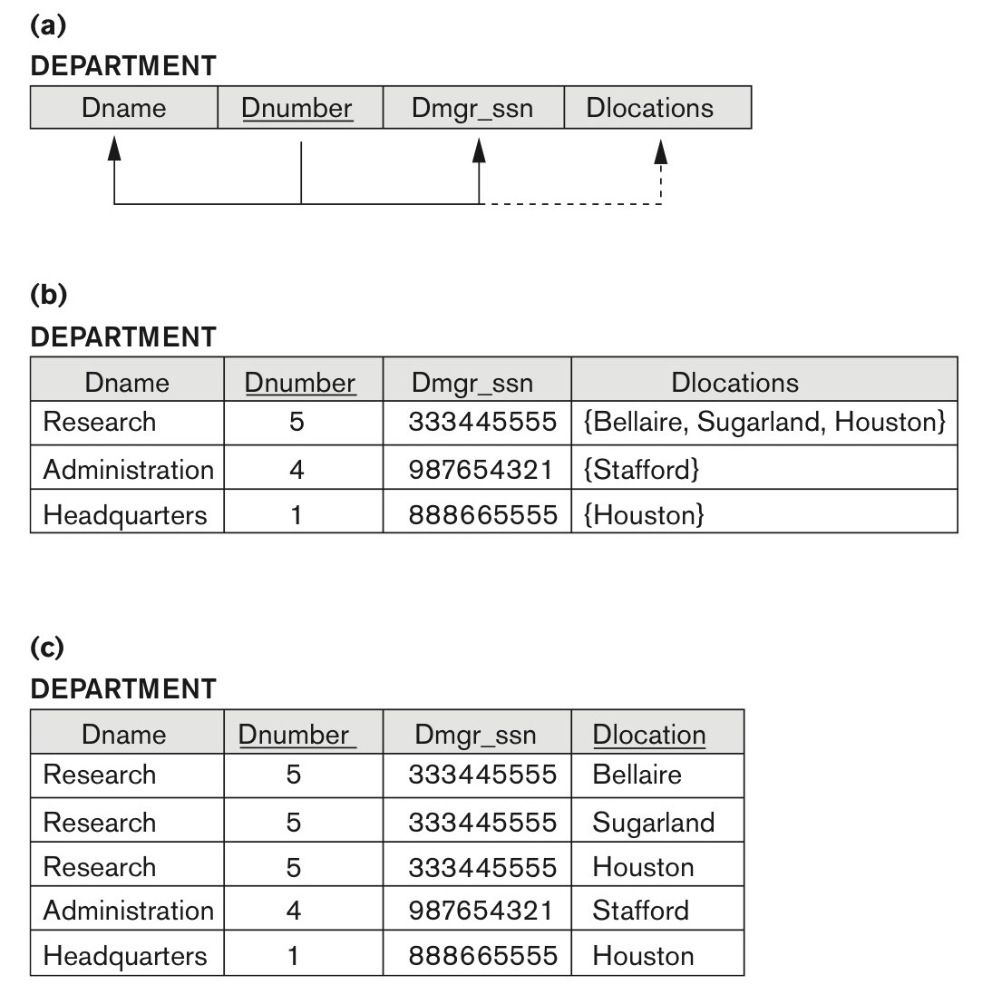
Normalization into 1NF
Notes:
Instructor (NetID, Name, Courses)

Slide 5
Second Normal Form
A relation is in second normal form (2NF) if every non-key attribute is fully functionally dependent on the primary key.

Slide 6
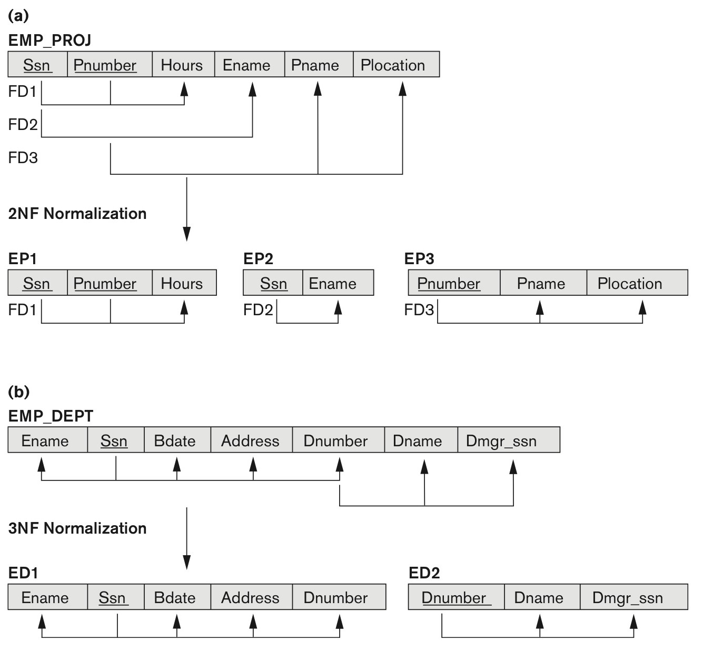
Normalizing into 2NF and 3NF
Notes:
Grade_Report (StudentID, CourseNo, Grade, StudentName, CourseName)

Slide 7
Third Normal Form
A relation is in third normal form (3NF) if it is in 2NF and no non-key attribute is transitively dependent on the primary key.
NOTE:
In X -> Y and Y -> Z, with X as the primary key, we consider this a problem only if Y is not a candidate key.
When Y is a candidate key, there is no problem with the transitive dependency .
E.g., Consider EMP (SSN, Emp#, Salary ).
Here, SSN -> Emp# -> Salary and Emp# is a candidate key.

Slide 8
Normalizing into 2NF and 3NF

Slide 9
Normal Forms Defined
1st normal form
All attributes depend on the key
2nd normal form
All attributes depend on the whole key
3rd normal form
All attributes depend on nothing but the key

Slide 10
Informal Guidelines for Good Database Design
GUIDELINE 1: Informally, each tuple in a relation should represent one entity or relationship instance.
Attributes of different entities (EMPLOYEEs, DEPARTMENTs, PROJECTs) should not be mixed in the same relation
Only foreign keys should be used to refer to other entities
Bottom Line: Design a schema that can be explained easily relation by relation. The semantics of attributes should be easy to interpret.

Slide 11
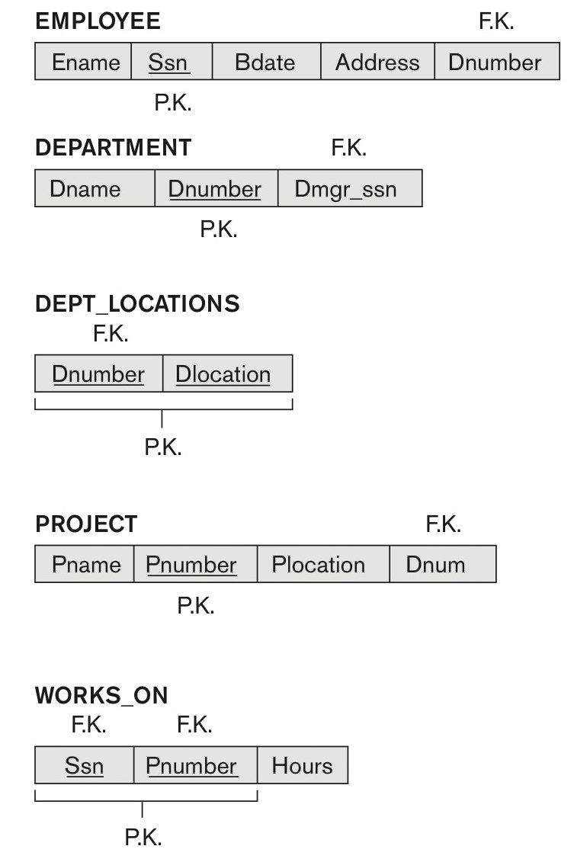
An example relational database schema

Slide 12
Informal Guidelines for Good Database Design
GUIDELINE 2:
Relations should be designed such that their tuples will have as few NULL values as possible
Attributes that are NULL frequently could be placed in separate relations (with the primary key)

